Slide 1
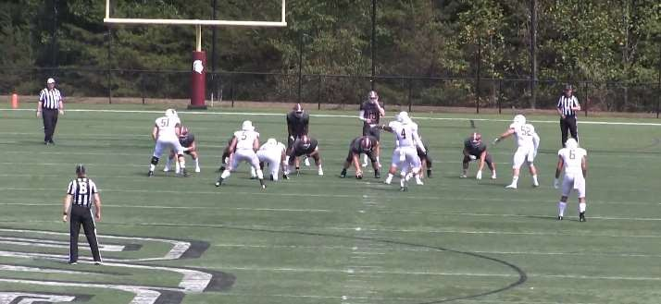
UMPIRE ALIGNING BEHIND THE OFFENSE
POSITION / MECHANIC
TIPS FOR THE UMPIRE FOR 2020

Slide 2
U ON RUNNING PLAY
RIGHT HANDED QB, FLIP FOR LEFT HANDED
Read run, hold position and move parallel to the LOS until the play goes past the LOS
Responsible for initial blocks by LG, C, RG, RT progress inside out.
Runs up the middle, assume responsibility for the left side of the POA and R takes the right side.
If runner goes to the R's side he would take the play to the sidelines and U clean up. If runner goes to the U's side, U would take him all the way to the sidelines and R clean up.
Once we clear our initial blocks, we officiate our zone picking up backs and pulling blockers that enter our zone.

Slide 3
IF QB DROPS BACK TO PASS
RIGHT HAND PASSER, FLIP FOR LEFT HANDED
R would have QB responsibility & U would have lineman blocking responsibilities. If QB scrambles and rolls to R's side, R keeps QB responsibilities all the way to the sidelines and U would have clean up responsibilities behind the LOS and spot the ball.
If QB scrambles to the U's side of the field, R would hand off QB responsibilities to the U and U would take him to the sidelines, R would have LOS clean up responsibilities and spot the ball.
Read pass, back out at a 45° angle.
If read pass, back out at a 45° angle
Be aware of the wide rush on the LT.
If the QB rolls to the left, we go with QB and the Referee takes the blockers.
Get to the sideline, especially the bench area, if QB goes out of bounds.

Slide 4
INELIGIBLE DOWNFIELD
The U is looking at the 5 interior lineman and if he sees a lineman going downfield
The L & LJ will have to help out when possible the R & U with this call. Same as passer across LOS.
Remember the R & U works toward the LOS when the ball doesn't go to their side of the field so they should be able to help with this.
Make way to the LOS and drop a flag for this foul.

Slide 5
SPOTTING THE BALL
U Responsible for spotting the ball between the hashes
U Responsible for spotting the ball when the play ends on the left side, inside the numbers without assistance.
When the play ends in the left side o utside the numbers, the Referee will spot the ball after a toss from the Umpire
When Referee goes outside the right hash to retrieve a ball, U should be at the right hash to spot the ball from Referee.
After spotting the ball, U should back out and can see the ball while moving
The Back Judge will assist in spotting the ball on long gains

Slide 6
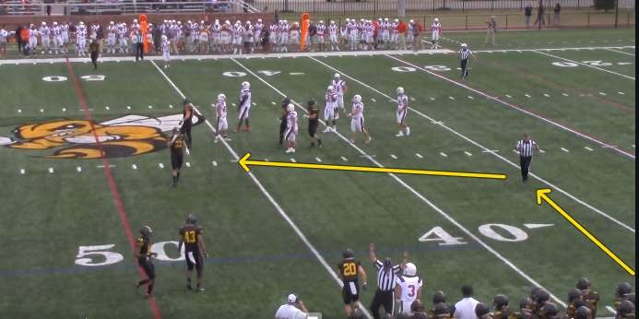
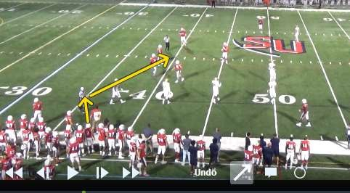
BALL ROTATION
The Ball People should be on the backfield side of the H & L
When new balls are needed, ball people will come in through the U and R
Left Side - U will get the ball from the ball person relay it to the R
Right Side – R will get the ball from the ball person and will toss it to the U at the right hash

Slide 7
HURRY UP
Depending on the side of the of the hashes that the ball becomes dead in, the position will dictate who has ball spotting responsibilities.
If the ball is between the hashes, the Umpire will assume ball spotting responsibilities.
Talk to the snapper and never allow the ball to be snapped until you are in position
Shut the play down and warn the team if this happens
Exception – If the ball goes in the U’s side zone, the U flips the ball into the R who spots, hold the ball and advised the center to hold the snap until the R clears. U moves to his regular position.

Slide 8
ON PUNTS
The Umpire stay in the offensive backfield focused on line play
R would always line up on the kicking leg and U would be opposite of R.
R would have kicker responsibilities and U would have snapper responsibilities and all other blocking responsibilities.
If a bad snap occurs and is recovered by receivers and advanced, R would have GL responsibilities and U would clean up behind.

Slide 9
SCORING KICKS – FG VS TRY
On Field Goals, the Umpire stay in the Offensive backfield when snapped outside the 15
On Field Goals, the Umpire stay under the upright when snapped inside the 15
On PAT, the Umpire stay under the upright when snapped inside the 15

Slide 10
SCORING KICKS – FG VS TRY
The Umpire stay in the offensive backfield focused on line play
R would always line up on the kicking leg and U would be opposite of R.
R would have kicker responsibilities and U would have snapper responsibilities and all other blocking responsibilities.
If a bad snap occurs and is recovered by receivers and advanced (FG only), R would have GL responsibilities and U would clean up behind.

